Slide 1
Community Health Workers (CHWs)
Student’s Name
University Department
Course Name/Number
Professor’s Name
Date

Slide 2
Introduction
Community Health Care Works (CHW) are core of healthcare system
They work in community settings
Others work in clinic or hospital settings
Work closely with the patients
Their duties can vary
Despite challenges they face like low wages,
CHWs continue to play a critical role in the health care sector
Notes:
I want to begin this presentation by stating that Community Health care Workers (CHWs) are important part of the healthcare system. Their roles vary due to the areas where they operate in which include community and hospital settings. This presentation will explain key roles of CHWs and the people they interact with as they undertake their duties as well as relate it with their responsibilities in the current health crisis, Covid-19.

Slide 3

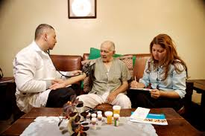
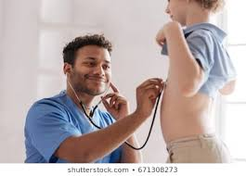
Who is a CHW
CHW, or community health care worker are trained health care workers who work from the community-centered approach
Roles designed to meet community needs
Notes:
A community health care worker refers to the health care providers whose roles are designed to meet the unique needs of the communities. They have been trained to provide community-centered services as shown in the slides below. As mentioned in the previous slide, their responsibilities are different due to the settings that they operate in; whether healthcare or social service settings.

Slide 4

Roles of CHWs
Their roles include
Link patients to healthcare system
Health screening and diagnostic process
Treatment management
Identify and reduce barriers to care
Taylor health education to patients in the community
Coordinate care
Provide patients with motivation and social support
Helps in maintenance or end of life (APHA, 2009)
Notes:
Community health care workers play important roles in the health in the health care system. According to American Public Health association, community health care workers act as educators as they provide important education to members of the community regarding their health status. CHWs play important roles as mentioned in this slde.

Slide 5
Education Background
As APHA states, CHWs do not have standardized education or certification
Most of them receive on-the-job training (APHA, 2009)
Trainings are tailored to suit the employer’s needs
Trainings are community-based and offered at community-based organizations
Others are offered at academic institutions
After completion of training, CHWs receive certification
Notes:
Currently, most states do not have a standardized education system that determine the educational requirement for community health care workers. States like New York have come up with trainings that are tailored towards meeting the community health needs. Every city and state have developed their own training guidelines that have contributed to the successful integration of the community health care workers in the health care system (APHA, 2009).

Slide 6

Skills Needed
Being a CHW requires one to possess skills such as:
Effective communication
Interpersonal relationships
Cultural competence
Assessment and evaluation skills
Advocacy skills
Education
Facilitation
Professional and training skills
Notes:
Community health care workers’ responsibilities involve communicating and interacting with the patients and other health care stakeholders in the community. As such, they are required to possess skills that would help them implement their duties and responsibilities effectively. These skills include effective commination and education skills to enable them implement the educational responsibilities. Other skills like cultural competence is important because they are directly involved with the people.

Slide 7
Population CHWs work with
CHWs work with various groups or population including:
People with pre-existing conditions like HIV-AIDS
Old people
Mentally ill individuals
Children
Other groups of people who need health care assistance like gestational women
These groups are more vulnerable to health problems
Therefore, they need constant monitoring
Notes:
Community health care workers interact and work with different vulnerable groups and population which include old people, people with pre-existing health conditions, the mentally challenged, and children. These groups are vulnerable to health problems. For example, people with pre-existing conditions like cancer, diabetes, and HIV/AIDS are required to constant take their medications. As such, monitoring and follow-up programs are important in ensuring that they meet their health needs. CHWs ensure that they are constantly in their medications and treatments through such follow-up programs.

Slide 8
Supply and Demand of CHWs
Most states do not have enough CHWs
The need for CHWs increases while the number is very low
With the wake of Covid-19 pandemic, states have realized the importance of CHWs
The current capacity of CHWs cannot meet the growing demands
New York has about 11,000 community health care workers
This does not reflect the growing need for them
Notes:
In the wake of Covid-19 pandemic, states are beginning to think the need to involve community health care workers in the fight against this health crisis. New York has about 11,000 CHWs who work in different areas in the state. Coronavirus pandemic has shown that every worker in the health care sector is important as the shortage in the health care workers call for serious interventions in the future.

Slide 9
CHW as a Growing Field
Covid-19 pandemic has proven that CHWs are important
Health care professionals are short-handed
They need any additional help they can get
CHWs are the perfect people to bridge the gap (Krause, 2020)
Community-based strategies are useful in combating public health problems like Covid-19
CHWs can educate people on the disease
Notes:
CHWs have numerous responsibilities that can be integrated in the health care system to enhance the fight against the current health crisis. Krause (2020) explains that CHW has proven useful in the past as the country combated pandemics like Ebola outbreak where the CHWs helped with the community-based strategy to help in educating the community on the disease. Similarly, CHWs can prove useful in the fight against Covid-19 crisis. They can help in detecting patients with the signs of the virus and get them to the hospital.

Slide 10
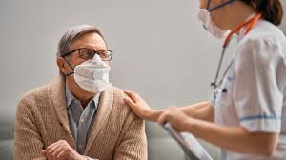
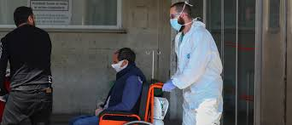
Integrating CHWs in the Health System
CHWs can work as full-time or part-time employees
This depends on the setting they work in
Most CHWs work on full-time basis
They work in social service organizations like nursing homes, mental health facilities, and even hospitals
Notes:
CHW needs to be integrated in the health system due to their effectiveness in coordinating community-centered health delivery strategies. They are critical in health service delivery not only in New York but across the country. They can work both as full-time or part-time employees. Even though most of them work on full-time basis, CHWs require recognition and proper training to equip them with the skills to help them fulfill their responsibilities.

Slide 11
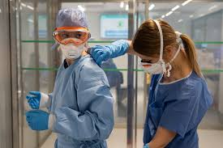
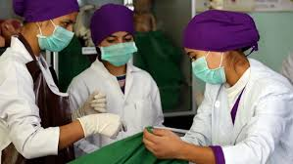
CHWS and Covid-19 Pandemic
Covid-19 crisis is here to stay
There is no vaccine or medication to control it
CHW could be the answer to providing continuous health care services in the communities
Covid-19 strains the health care resources
CHWs can provide home-based care
Full integration in
the health care system
is important
Notes:
As I conclude this presentation, I want to state that covid-19 pandemic has proven to many states that the health care services are not enough. Also, there is still great disparity in the care deliveries. Bridging this gap can only be achieved by fully integrating the CHWs in the health care system to implementing the outreach and public education programs because they are in constant touch and interaction with the community members. They can help in the fight against covid-19 in contact tracing, educating the community on the prevention strategies, and connect the community with the health care institutions.

Slide 12
References
APHA. (2009 November, 10). “Support for Community Health Workers to Increase Health Access and Reduce Health Inequalities.” American Public Health Association (Online). https://www.apha.org/policies-and-advocacy/public-health-policy-statements/policy-database/2014/07/09/14/19/support-for-community-health-workers-to-increase-health-access-and-to-reduce-health-inequities
Krause, K. (2020 April, 12). “Could a new Public Health Corps create Jobs while battling Covid-19.” The Dallas Morning News (Online). https://www.dallasnews.com/business/health-care/2020/04/12/could-a-new-public-health-corps-create-jobs-while-battling-covid-19/

